Slide 1
Advanced Programming
Module Project
Module: Web Development Using Platforms
Start Date : 04/04/2023
End Date : 08/04/2023
Submission Date : 08/04/2023
Learner Name : Syukur Sidiq Nur Alam
Enrollment ID : BDSE0922-089
Presentation Date :

Slide 2
Contents
Contents
S. No. | Description
01 | List of software used
02 | OO Paradigm
03 | Class Relationships
04 | Class Diagram
05 | Developing Triple A portlet
06 | Customer Management Portlet
07 | Design Patterns
08 | Creational Design Patterns
09 | Structural Design Patterns
10 | Behavioural Design Patterns
11 | Project Results

Slide 3




1. List of software used

Slide 4
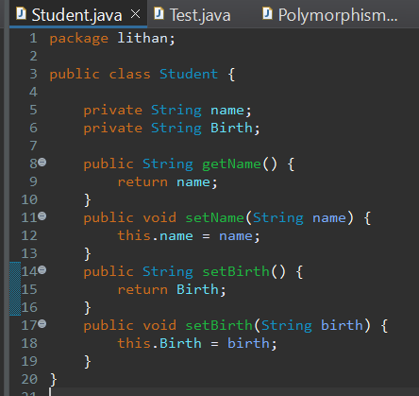
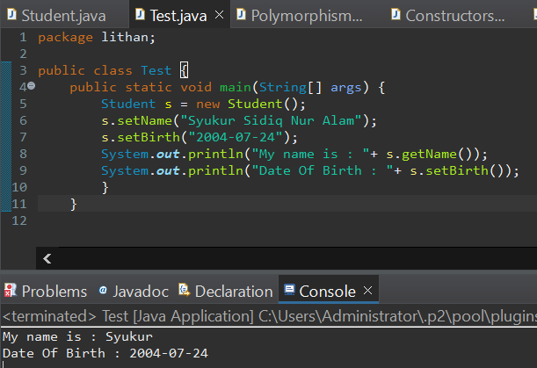
2. Object Oriented Paradigm
Encapsulation
Encapsulation is the wrapping of data or hiding personal data from an object so that it cannot be accessed from other objects. Can only access using the current class, getter and setter methods.
Make Student.java and make the object. Make it private

Slide 5
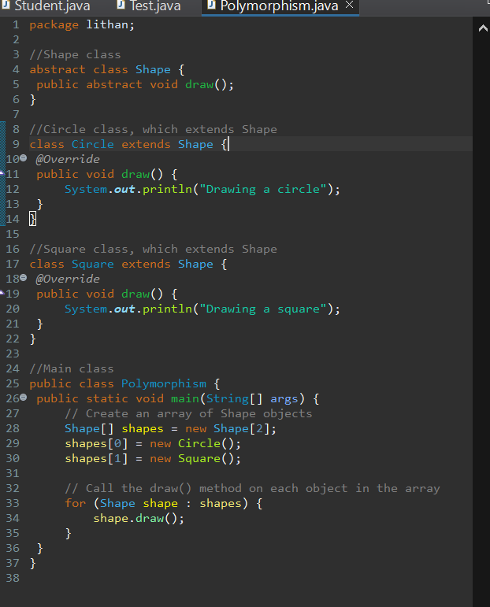
2. Object Oriented Paradigm
Polymorphism
Polymorphism allows different objects to be treated as if they were the same type of object, even if they are actually different. This can be useful when working with collections of objects, as it allows you to treat them all as if they were the same type of object, even if they have different behaviors.

Slide 6
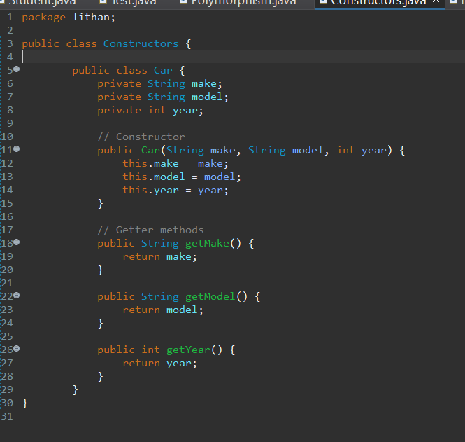
2. Object Oriented Paradigm
Constructor
Constructor is a special method that is used for initialization when creating an object. The constructor is called as soon as the new object is created. The feature of the constructor is that the method name exactly matches the class name.
Remember when you creating constructor the name must same with the class. This is ConstructorExample.java with result

Slide 7
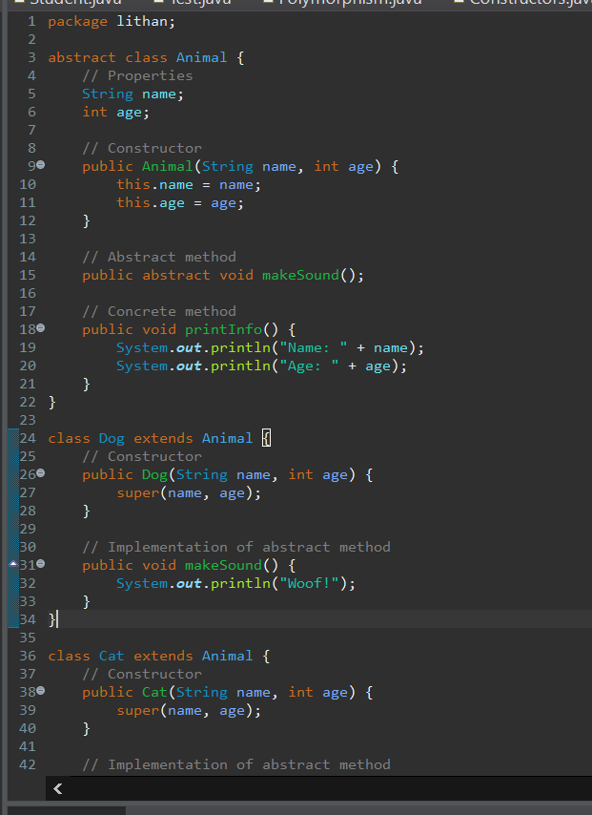
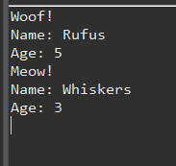
2. Object Oriented Paradigm
Abstract
An abstract class serves as a blueprint for other classes to follow. It defines a set of common methods and properties that its subclasses must implement. However, it cannot be instantiated on its own. Instead, it must be extended by a concrete class that provides implementations for all its abstract methods.

Slide 8
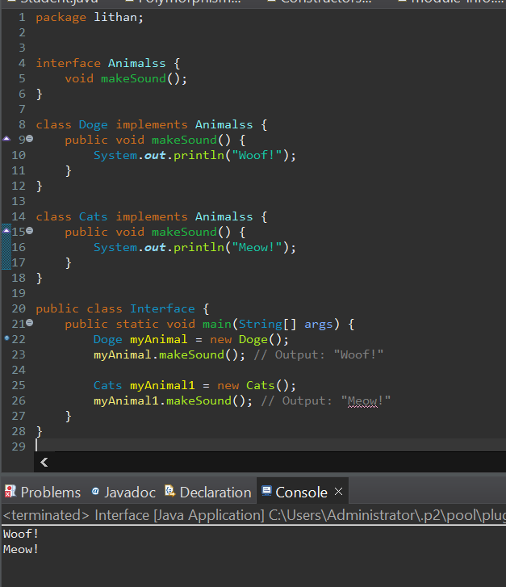
2. Object Oriented Paradigm
interface
interface is a programming construct that defines a set of methods or functions that a class must implement. It is a contract that specifies what the class should do but not how it should do it. Interfaces define a set of public methods that can be called by other objects without revealing the internal workings of the object. They allow for loose coupling between different objects, promoting code reusability. By programming to an interface instead of a specific class, you can change the implementation of an object without affecting other objects that depend on it.

Slide 9
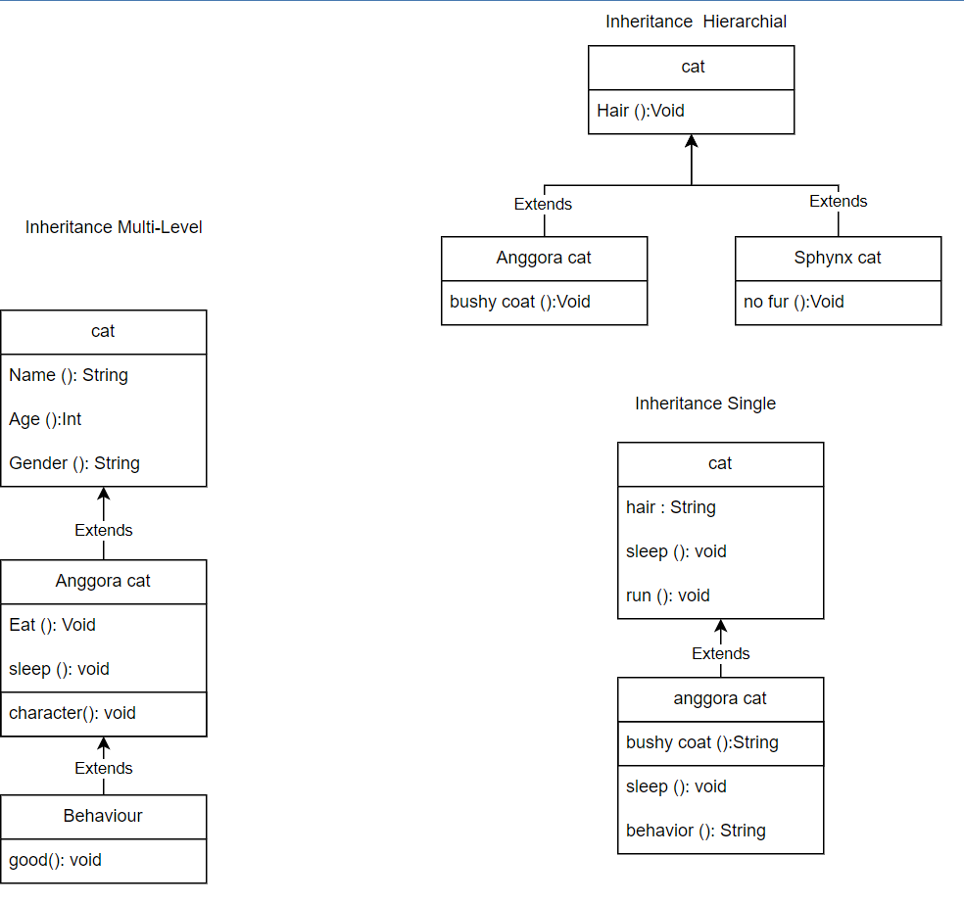
3. Class Relationships
Inheritance
The "is-A" relationship between two classes, primarily the parent class and the child class, which inherits the parent's structure and behavior, is represented by inheritance, also known as generalization. A solid line arrow clearly illustrates the relationship (hollow arrowhead). The three inheritance types are demonstrated below:

Slide 10
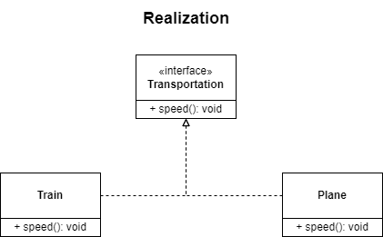
3. Class Relationships
Realization
Realization is seen in interfaces when the blueprint class is paired with an object to carry out each detail. A dashed line with a hollow arrowhead can be used to indicate a relationship.

Slide 11
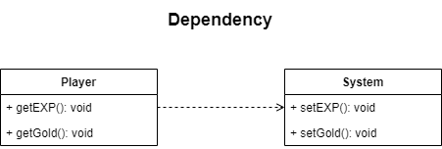
3. Class Relationships
Dependency
Dependency is when class A is dependent on class B. Therefore, when class B changes, class A will also be affected by the change. A dashed line with an open arrow can represent this relationship.

Slide 12
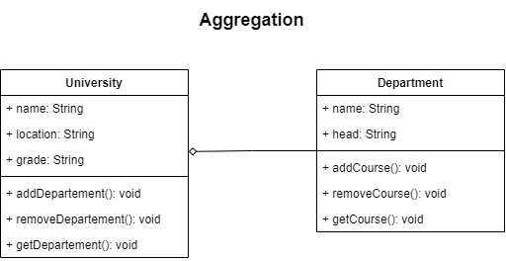
3. Class Relationships
Aggregation
Aggregation is the single point of control where it aggregates or assembles a group of objects that is part of the object which aggregate. The part of the relationship can be represented by a solid line with an unfilled diamond at the parent end connected to the child class. In this case, if the parent is deleted, the child class can still exist independently.

Slide 13
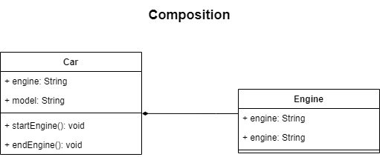
3. Class Relationships
Composition
Composition is the stronger form of aggregation. In this case, if the source or the aggregator is destroyed, then part of it is also destroyed with it and cannot stand by itself. The relationship is displayed with a solid line and the filled diamond at the associated/source end connected to the composite class.

Slide 14
4. Class Diagram
What is Class Diagram
Class diagrams are an effective tool for describing various design patterns. In many cases, a class diagram is actually required to fully represent the key elements of a particular pattern. This is because class diagrams provide a complete representation of the static structure of the system while emphasizing key connections between classes, objects, traits and activities. By providing a conceptual model of the system in terms of entities and their relationships, class diagrams help designers better understand the overall architecture of the system and identify key areas for optimization and development. Incorporating classes, interfaces, relationships, collaborations, and constraints into well-designed class diagrams can withstand even the most difficult and complex real-world scenarios.
Modifiers are used to indicate visibility of attributes and operations.
1. ‘+’ is used to denote Public visibility (everyone)
2. ‘#’ is used to denote Protected visibility (friends and derived)
3. ‘-’ is used to denote Private visibility (no one)
By default, attributes are hidden and operations are visible.

Slide 15
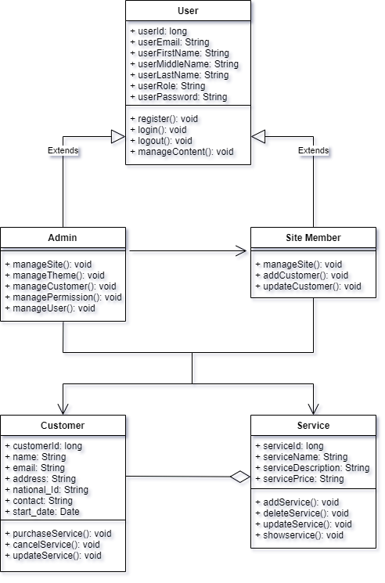
4. Class Diagram

Slide 16
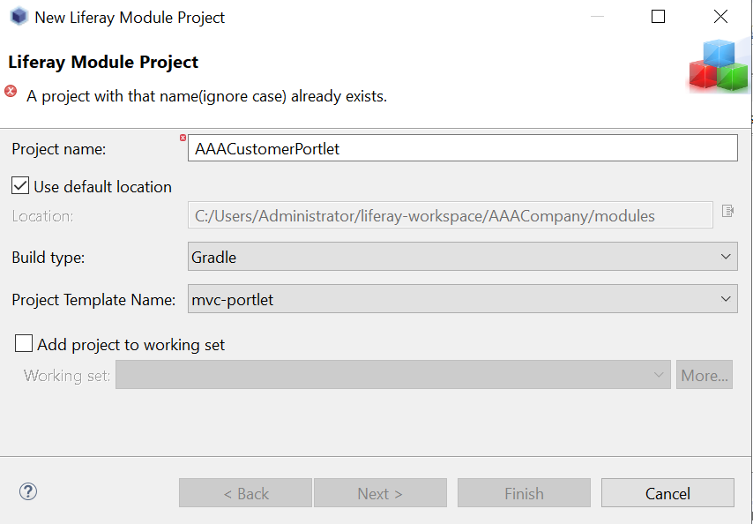
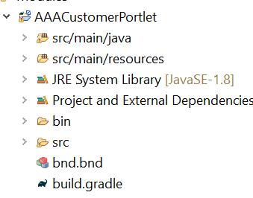
5. Developing Triple A portal
Create MVC Portlet
Create new modules on liferay workspace

Slide 17
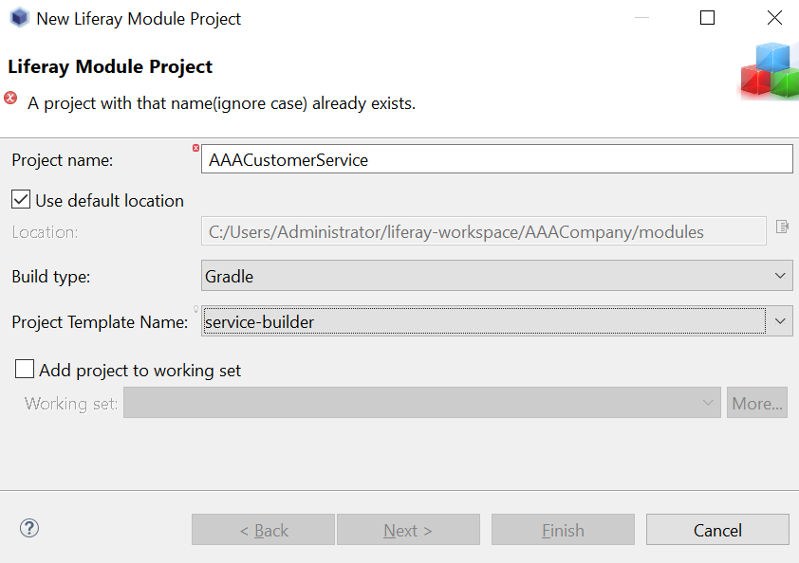
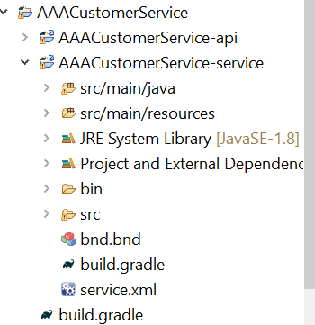
5. Developing Triple A portal
Create MVC Portlet
Create new modules on liferay workspace

Slide 18
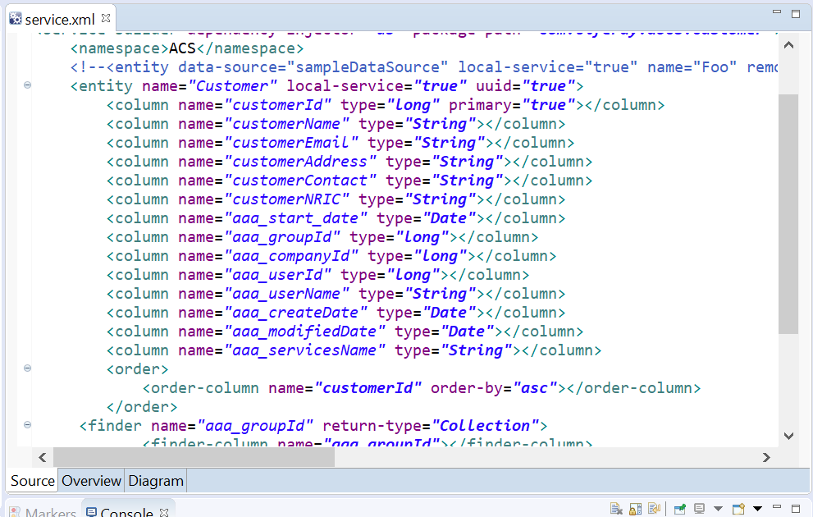
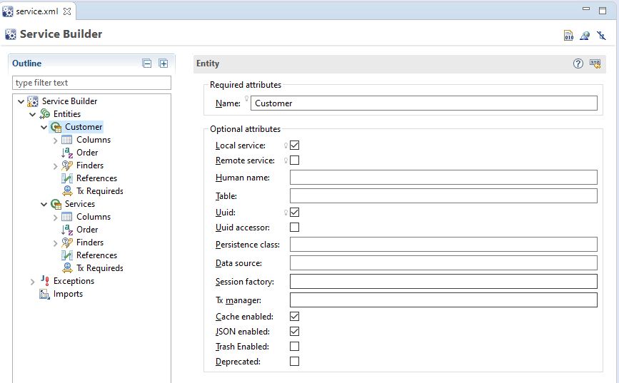
5. Developing Triple A portal
Create Customer Entity

Slide 19
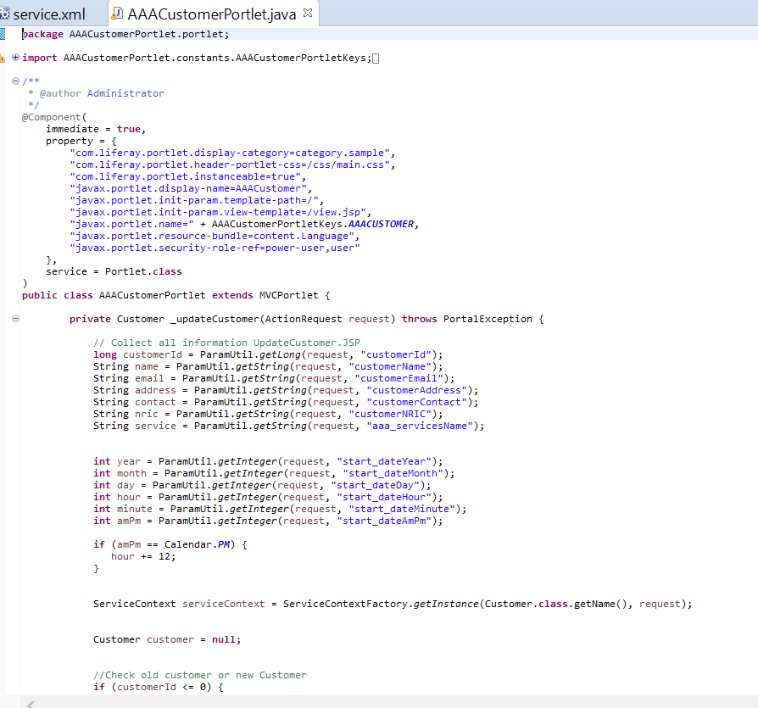
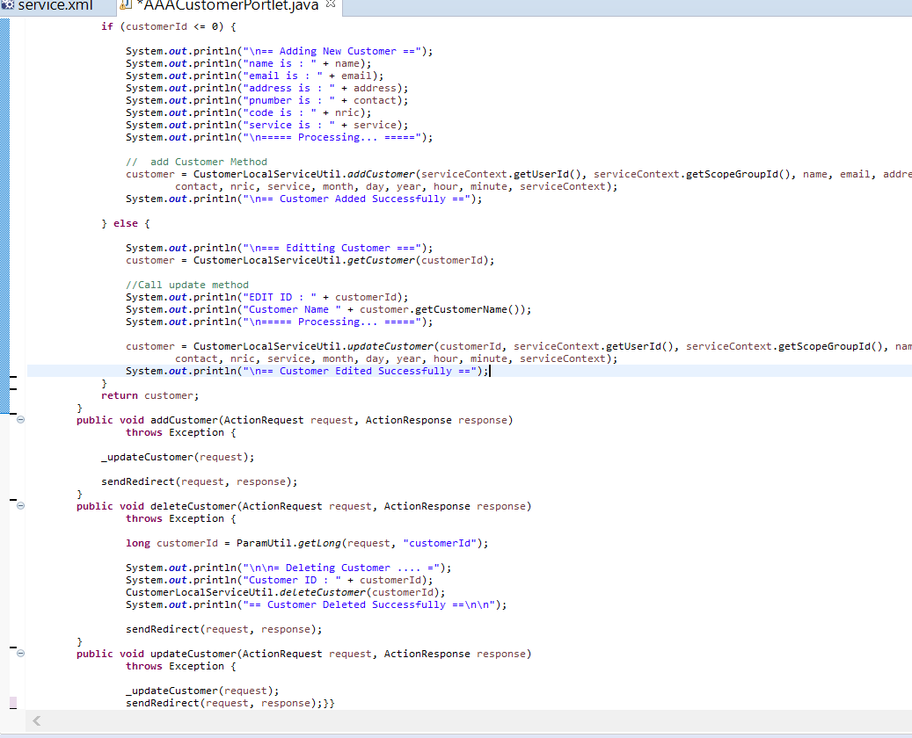
5. Developing Triple A portal
Coding screen captures

Slide 20
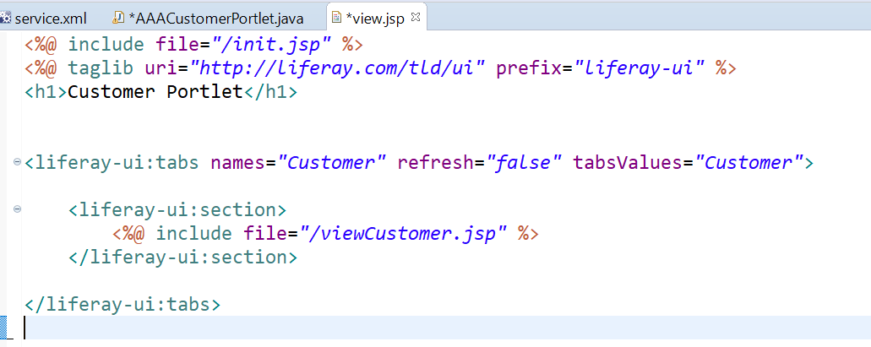
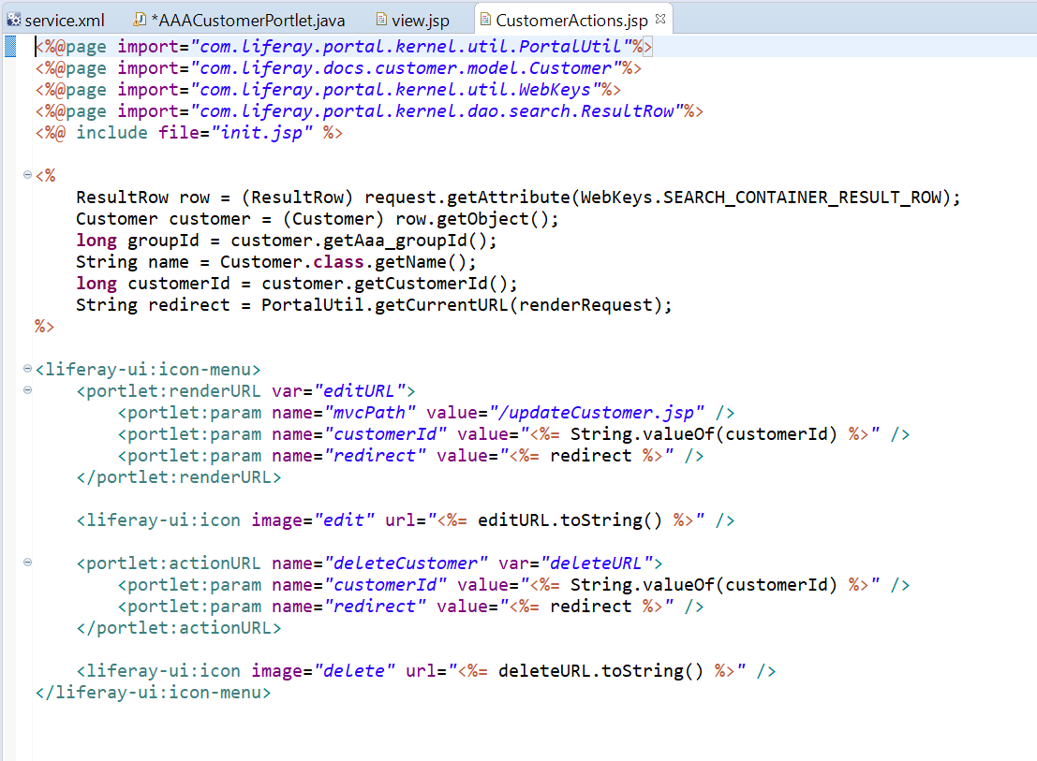
5. Developing Triple A portal

Slide 21
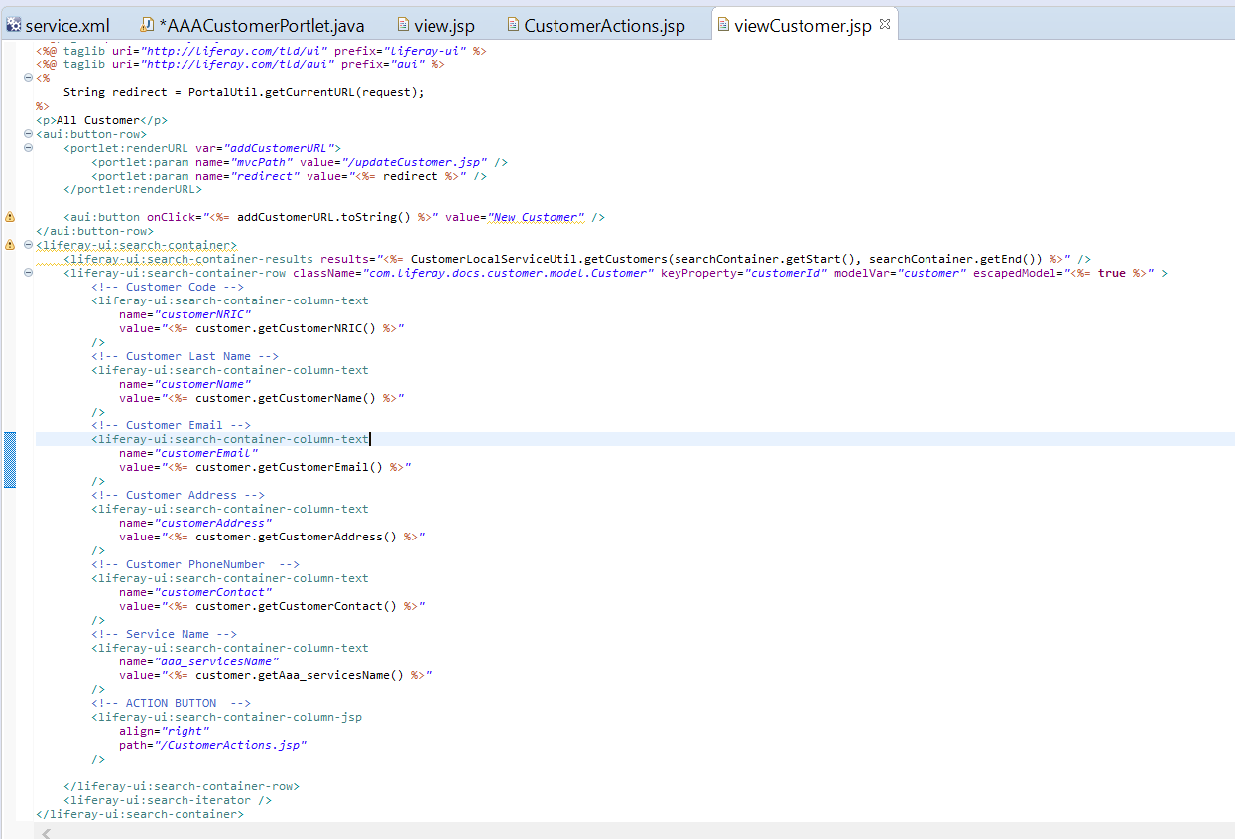
5. Developing Triple A portal

Slide 22
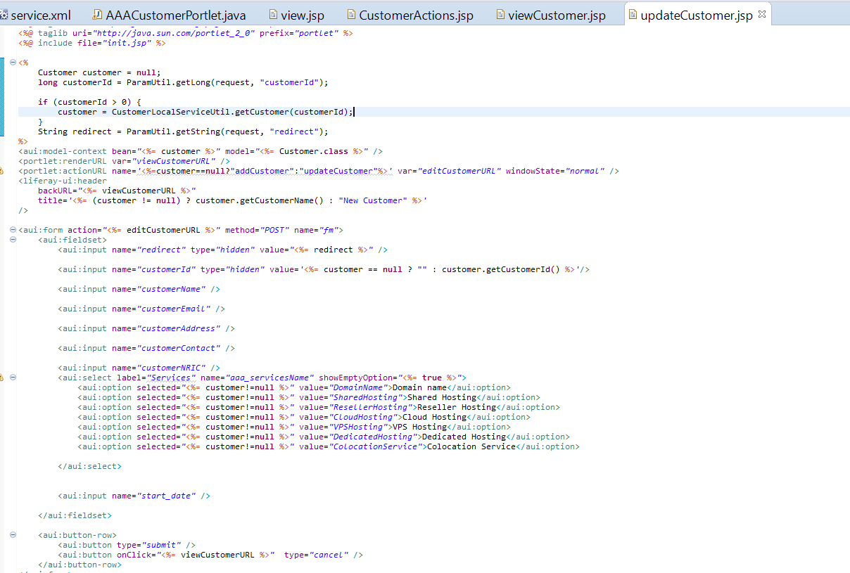
5. Developing Triple A portal

Slide 23
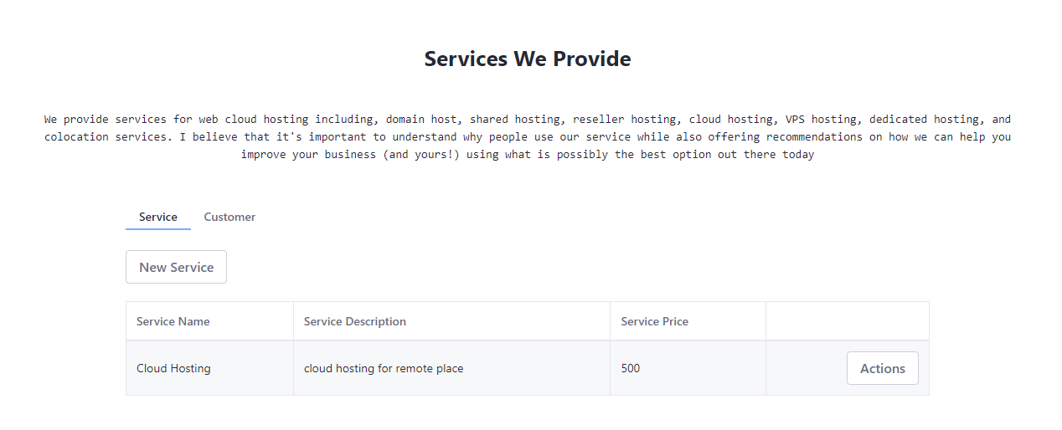
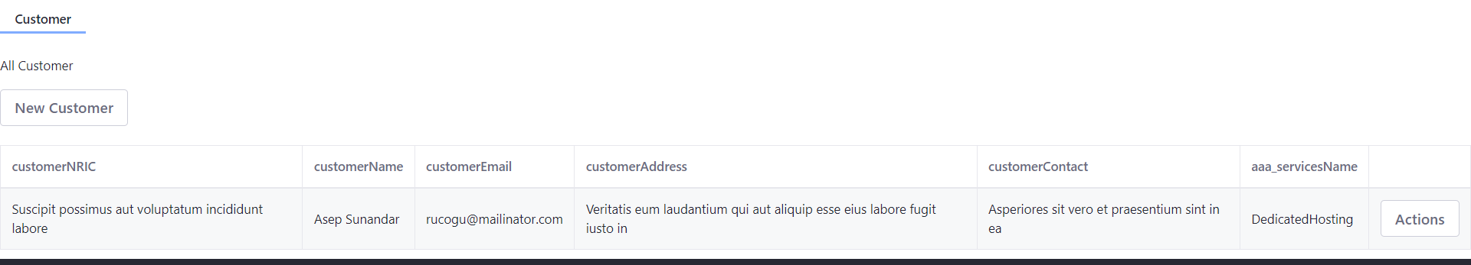
6. Customer Management Portlet

Slide 24
7. Design Patterns
Definition of Design Pattern
design pattern is a general repeatable solution to a commonly occurring problem in software design. A design pattern isn't a finished design that can be transformed directly into code. It is a description or template for how to solve a problem that can be used in many different situations.

Slide 25
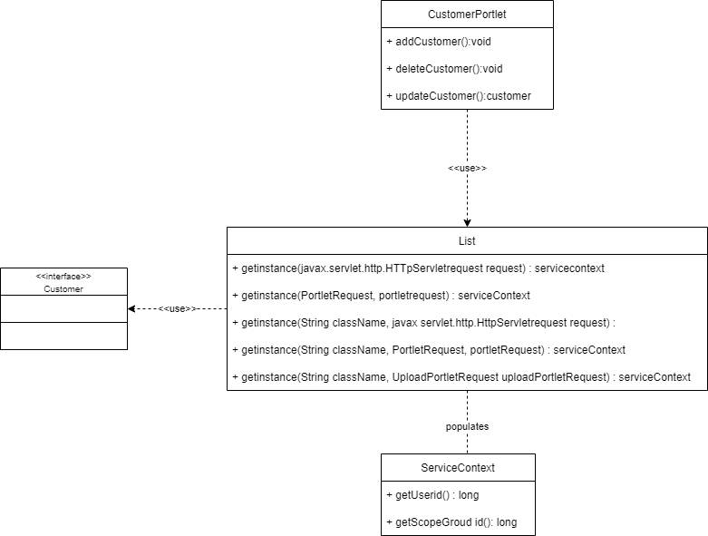
8. Creational Design Patterns
Creational design patterns
Creational design patterns are concerned with the way of creating objects. These design patterns are used when a decision must be made at the
time of instantiation of a class (i.e. creating an object of a class).
Types of creational design patterns
Factory Method Pattern
Abstract Factory Pattern
Singleton Pattern
Prototype Pattern
Builder Pattern
Object Pool Pattern

Slide 26
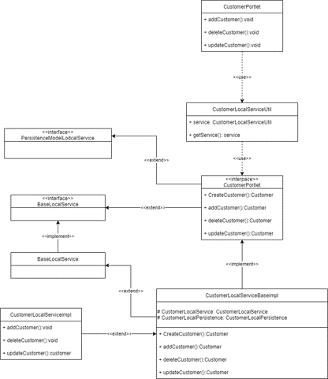
9. Structural Design Patterns
Structural design patterns are concerned with how classes and objects can be composed, to form larger structures.
The structural design patterns simplifies the structure by identifying the relationships.
These patterns focus on, how the classes inherit from each other and how they are composed from other classes.
Types of structural design patterns
Adapter Pattern
Bridge Pattern
Composite Pattern
Decorator Pattern
Facade Pattern
Flyweight Pattern
proxy Pattern

Slide 27
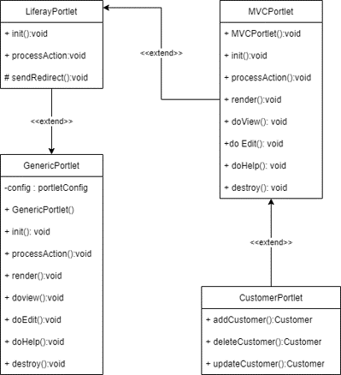
10. Behavioural Design Patterns
Behavioral design patterns are concerned with the interaction and responsibility of objects.
In these design patterns, the interaction between the objects should be in such a way that they can easily talk to each other and still should be loosely coupled.
That means the implementation and the client should be loosely coupled in order to avoid hard coding and dependencies.
There are 12 types of behavioral design patterns
Chain of Responsibility Pattern
Command Pattern
Interpreter Pattern
Iterator Pattern
Mediator Pattern
Memento Pattern
Observer Pattern
State Pattern
Strategy Pattern
Template Pattern
Visitor Pattern
Null Object

Slide 28

11. Project Result
Homepage

Slide 29

11. Project Result
Services

Slide 30
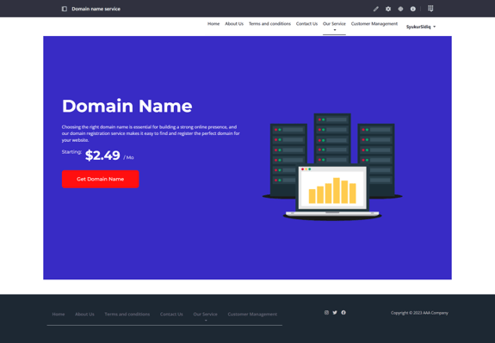
11. Project Result
Domain Name Service

Slide 31

11. Project Result
Shared Hosting Service

Slide 32

11. Project Result
Reseller Hosting Service

Slide 33

11. Project Result
Cloud Hosting Service

Slide 34

11. Project Result
VPS Hosting Service

Slide 35

11. Project Result
Dedicated Hosting Service

Slide 36

11. Project Result
Colocation Service

Slide 37
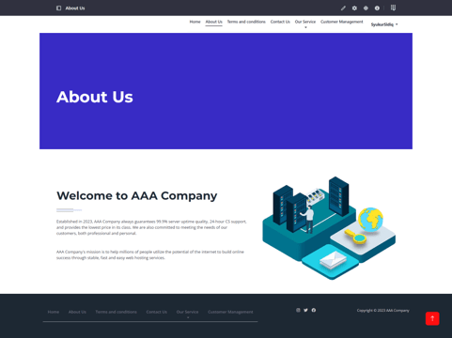
11. Project Result
About Us Page

Slide 38
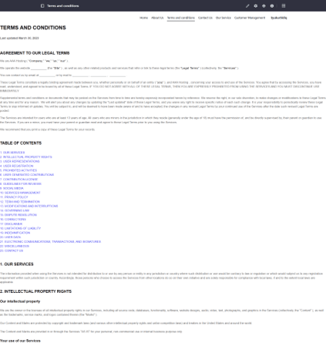
11. Project Result
Terms and Conditions Page

Slide 39

11. Project Result
Contact Us Page

